Slide 1

Northwind Sales Review 1997
Data Engineering Mini Project
DSLS 2023
Author : Ihsan Nur Faqih

Slide 2

Executive Summary
Product Perspective
Sales performance in 1997 is stagnant and driven by several event (Christmas & New Year)
Bucket size of each customer varied and have range from 500-600 USD/transaction
Sales revenue mainly driven by Dairy Products, Beverages, Convection, and Meat/Poultry
Product bundling might be good solution to increase bucket size and overall revenue
Customer Perspective
Mostly our customer are in hibernating & at-risk state that have potential losing 33 customers and 6.000 USD average sales/year
Reward strategy for Loyal Customer, Potential Loyalist, and Champions are needed to increase their sales bin (potential gain 41.000 USD average sales/year)
There is a customer that segmented as “can not lost” that have 23.000 USD average sales/year must be maintained
Customer Retention
From the cohort chart we can inference that there is very high fluctuation over time in customer retention
Average retention rate for every cohort are below 50%
Buyers from first cohort (1997-01) seems have better retention than another cohort, since a year from first purchase the retention rate still in 52%
Strategy for maintain retention need to be develop, since our main business is retail hence, we must make our customer to do repeat order, or periodical order.

Slide 3
Contents
Data Acquisition
Product Analysis
Customer Analysis
Cohort Analysis

Slide 4
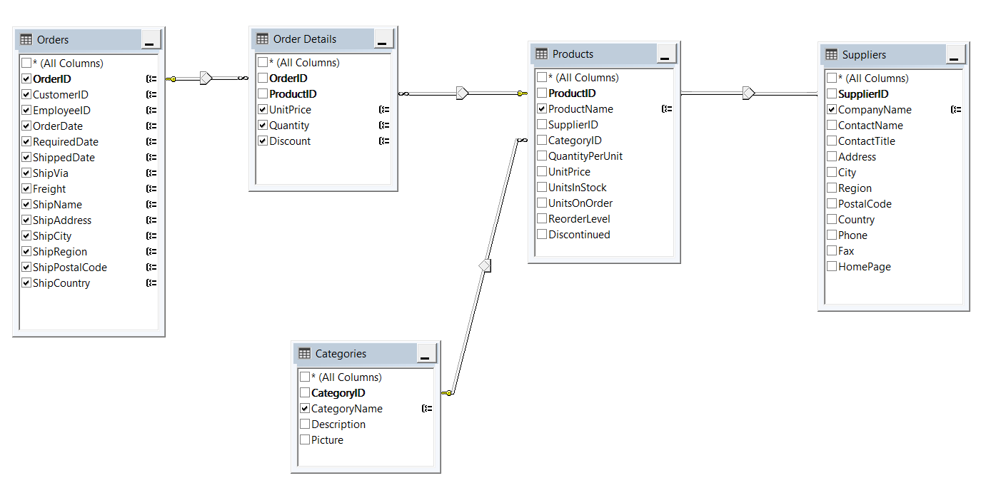
Data Acquisition
Generating OrderFact (will be used for Product Analysis)
OrderFact :
A view table in Northwind DB that can be used by data analyst to analyze product sold over times (including category, price, quantity, discount applied), from which supplier, how the freight are made, etc.

Slide 5
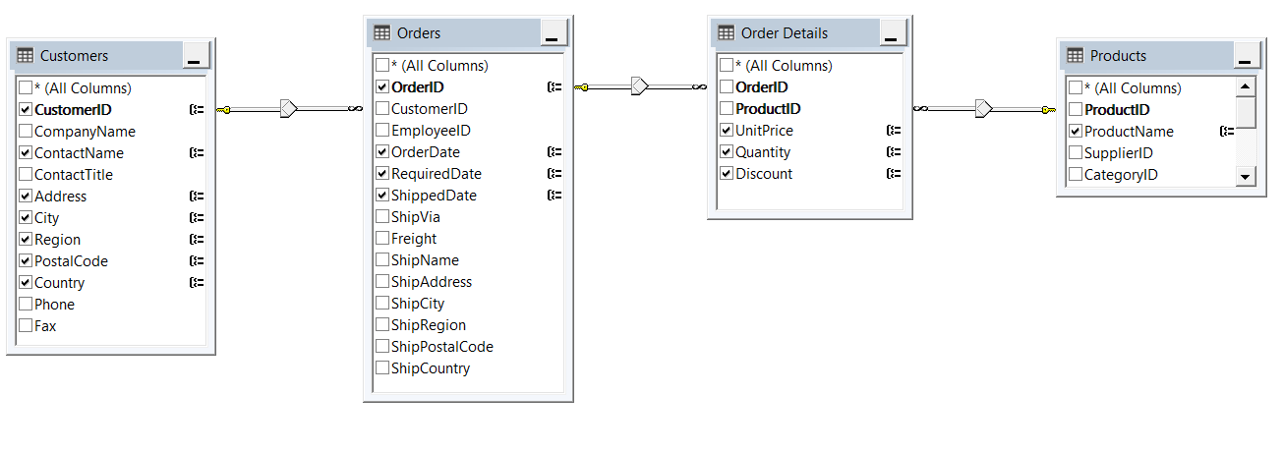
Data Acquisition
Generating CustomerFact (will be used for Customer & Cohort Analysis)
OrderFact :
A view table in Northwind DB that can be used by data analyst to analyze customers demographic (how much money they spent, when they bought from us, price they got, quantity, product they bought, etc.)

Slide 6
Contents
Data Acquisition
Product Analysis
Customer Analysis
Cohort Analysis

Slide 7
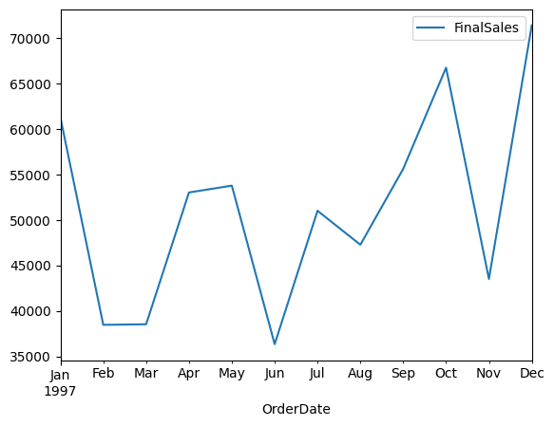
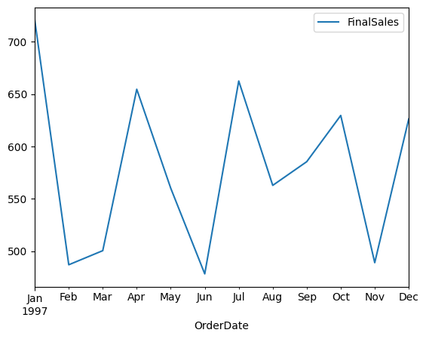
Northwind sales revenue is stagnant in 1997
Peak sales performance have been driven by some event (Christmas & New Year)
Even though sales performance is increasing, bin size of transaction is stagnant (500 – 600 USD/transaction)
Monthly Sales Revenue (in USD)
Monthly Bin Size Transaction (in USD)
Peak sales in 1997

Slide 8
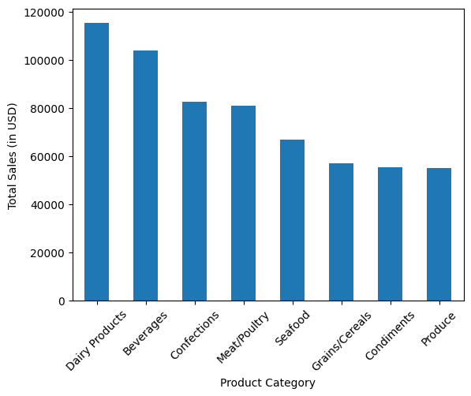
Dairy Product, Beverages, Convections are top 3 sales in 1997
Sales revenue mainly driven by Dairy Products, Beverages, Convection, and Meat/Poultry
Grains/Cereals, Condiments, and Procedure are top bottom product
Total Revenue by Product Category

Slide 9
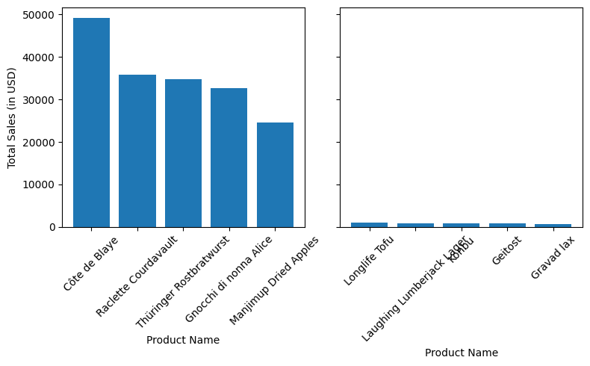
Product Bundling Could be A Solution for Stagnant Sales
Create bundling product combination between top 5 products sales and bottom 5 product sales could be a solution to increase sales revenue by increasing bin size of customer (*)
Top & Bottom 5 Sales by Product Name
*Every country has different product preference please check appendix for top and bottom sales for every country

Slide 10
Contents
Data Acquisition
Product Analysis
Customer Analysis
Cohort Analysis

Slide 11
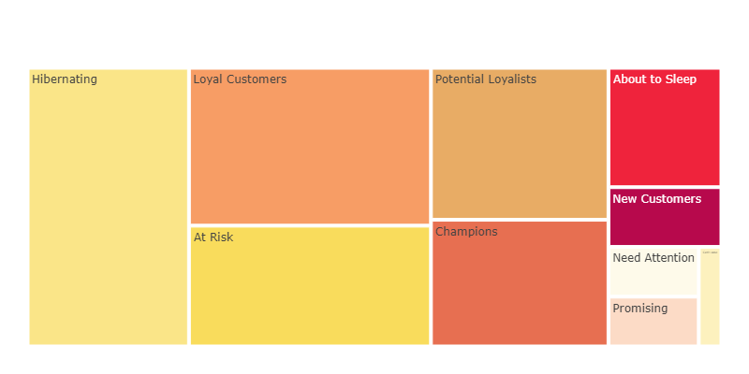
Mostly Our Customer are in Hibernating & At-Risk State Based on RFM Segmentation
Customer State Distribution
Key Takeaway(*) :
Mostly our customer are in hibernating & at-risk state that have potential losing 33 customers and 6.000 USD average sales/year
Reward strategy for Loyal Customer, Potential Loyalist, and Champions are needed to increase their sales bin (potential gain 41.000 USD average sales/year)
There is 1 can not lost customer that have average sales 23.000 USD average sales/year must be maintained
20 customers
17 customers
12 customers
13 customers
10 customers
*Data details please check on appendix

Slide 12
Contents
Data Acquisition
Product Analysis
Customer Analysis
Cohort Analysis

Slide 13
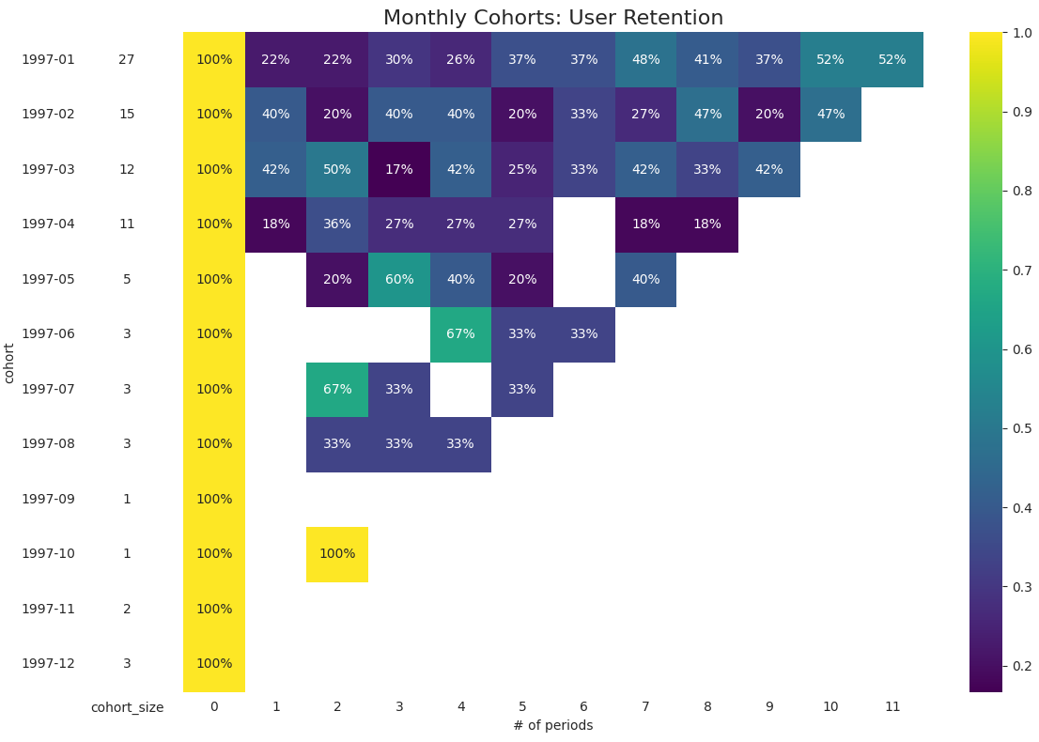
Sharp Drop-off Customer Retention in 2nd Month
Key Takeaway :
From the cohort chart we can inference that there is very high fluctuation over time in customer retention
Average retention rate for every cohort are below 50%
Buyers from first cohort (1997-01) seems have better retention than another cohort, since a year from first purchase the retention rate still in 52%
Strategy for maintain retention need to be develop, since our main business is retail hence, we must make our customer to do repeat order, or periodical order.

Slide 14
APENDIX

Slide 15
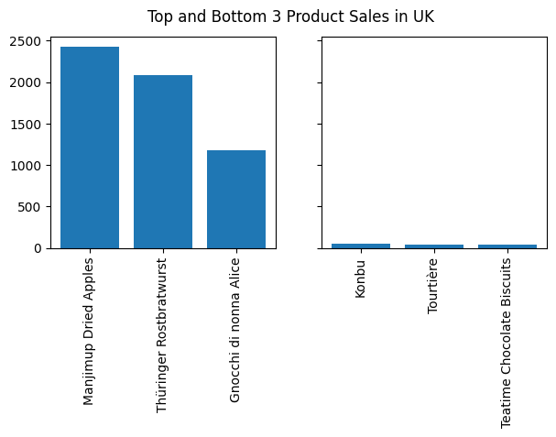
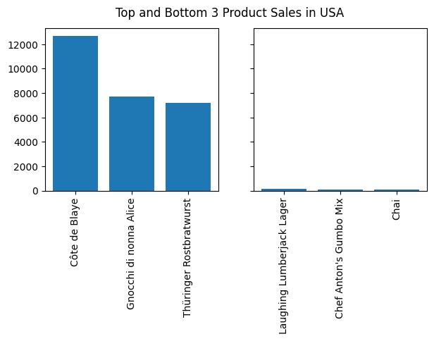
Product Preference in Each Operation Country (1)

Slide 16
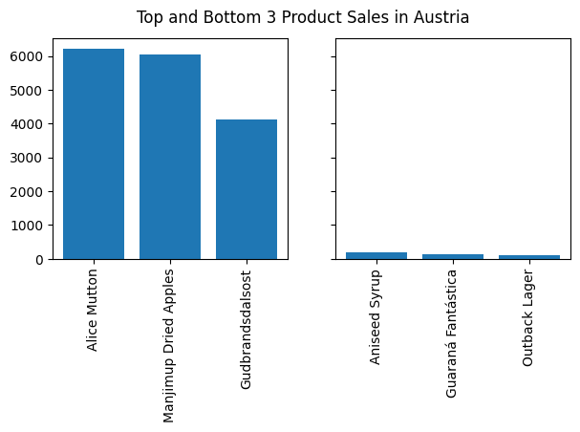
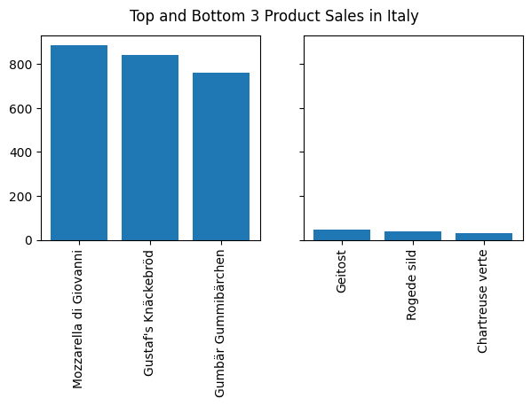
Product Preference in Each Operation Country (2)

Slide 17
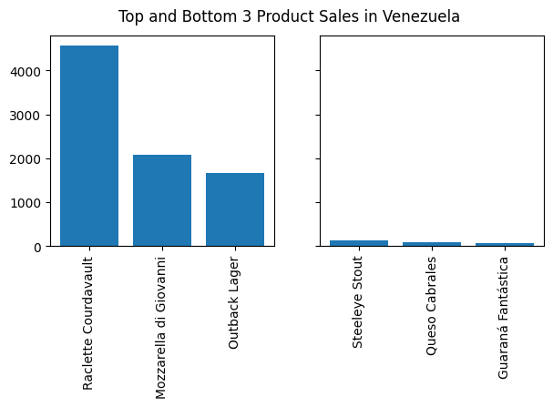
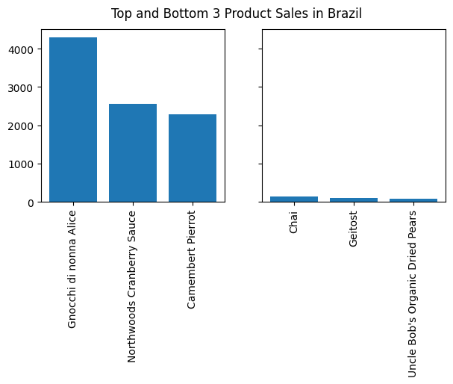
Product Preference in Each Operation Country (3)

Slide 18
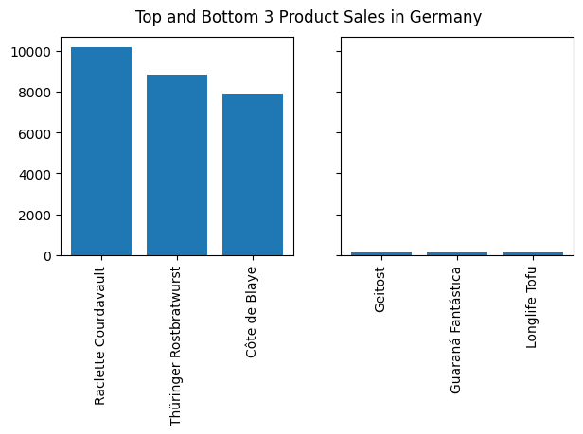
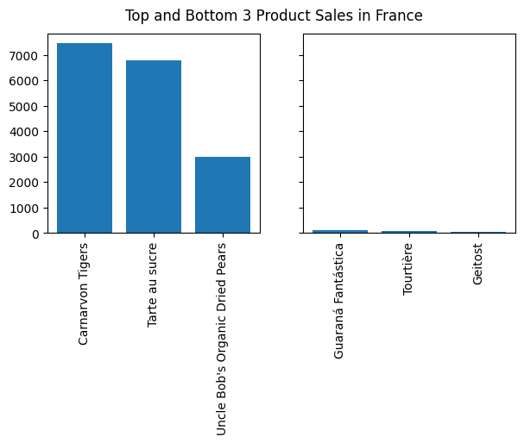
Product Preference in Each Operation Country (4)

Slide 19
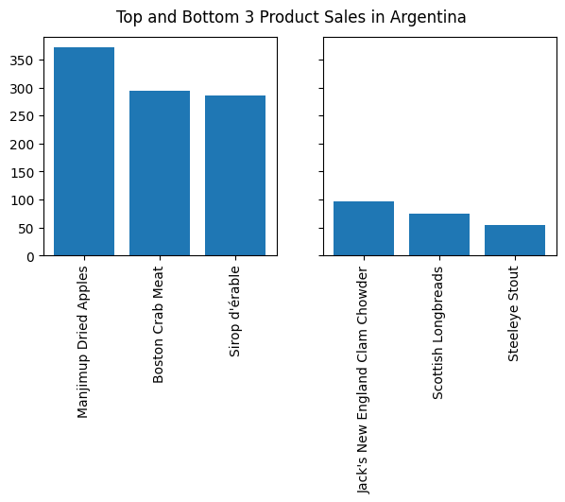
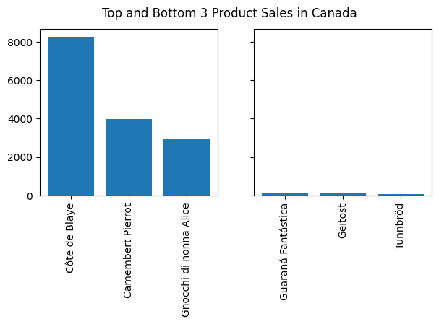
Product Preference in Each Operation Country (5)

Slide 20
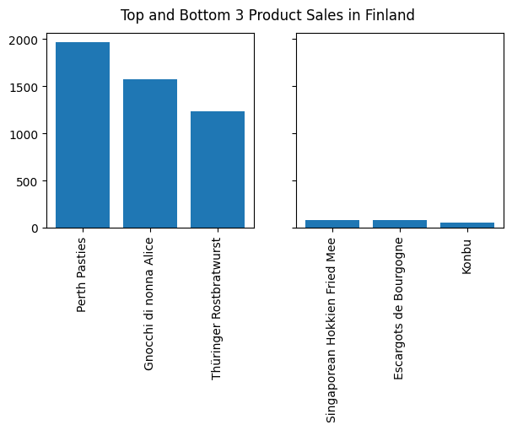
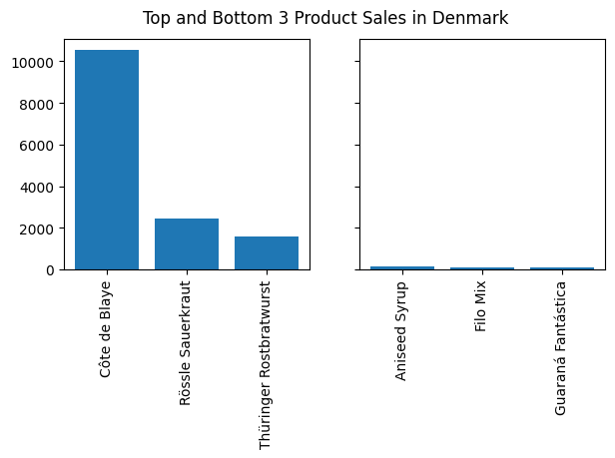
Product Preference in Each Operation Country (6)

Slide 21
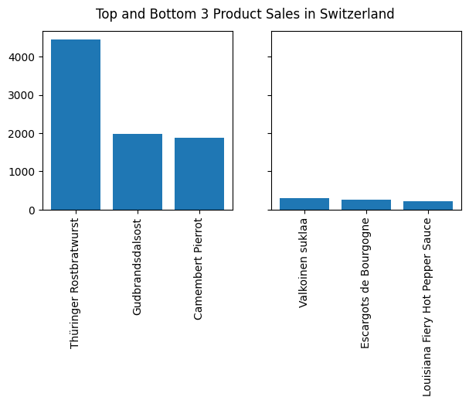
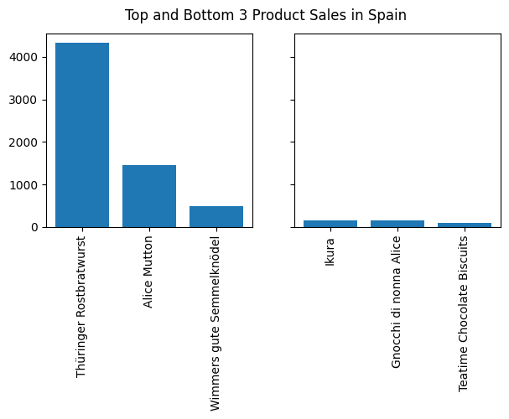
Product Preference in Each Operation Country (7)

Slide 22
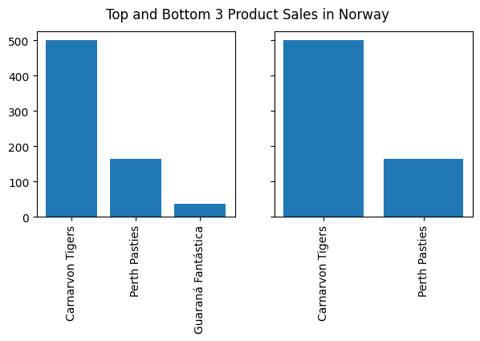
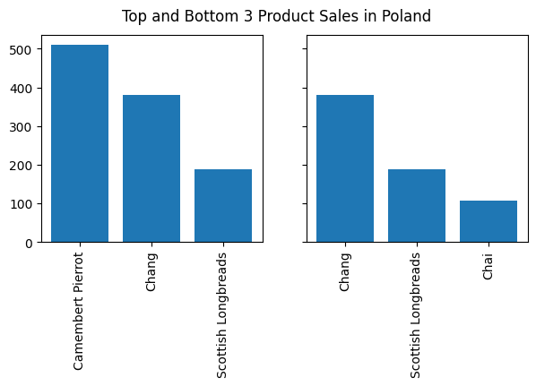
Product Preference in Each Operation Country (8)

Slide 23
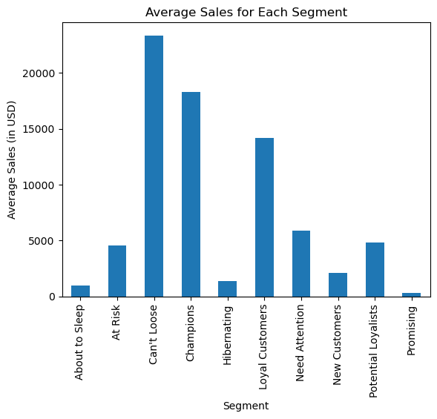
Average Sales from Each Segment

